Slide 1
About this deck….
Hello!
This deck is provided along with a collection of resources to help you host a generative AI themed event that will inform, educate and delight.
Synopsis:
This talk explores the rise of generative AI and its implications for the future of work. It begins by defining generative AI and contrasting it with traditional machine learning approaches. It then examines how technologies that automate aspects of work have impacted jobs throughout history. The talk highlights specific tech roles poised to be augmented by generative AI and discusses the challenges, concerns, and potential mitigations around this emerging technology. It provides guidance on how employers and employees can prepare for a generative AI-driven future of work. The presentation concludes by showcasing tools and resources for learning and building with generative AI, enabling attendees to participate in shaping this technological transformation. With an engaging storytelling approach, this talk offers a balanced perspective on generative AI's impact while equipping the audience to capitalize on its opportunities.
Level: 100
(*The level can be adjusted by the presenter to meet the needs of the audience.)

Slide 2
Generative AI and the Future of Work

Slide 3

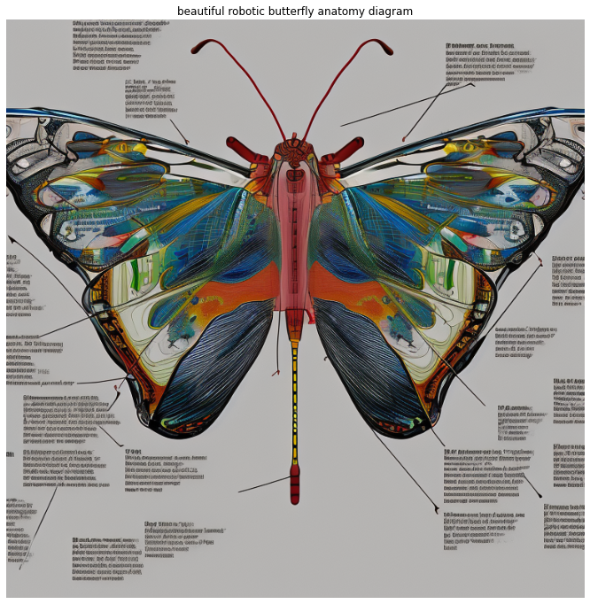
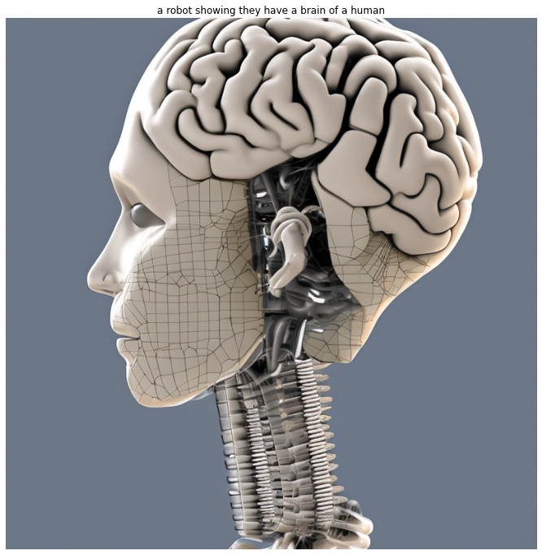
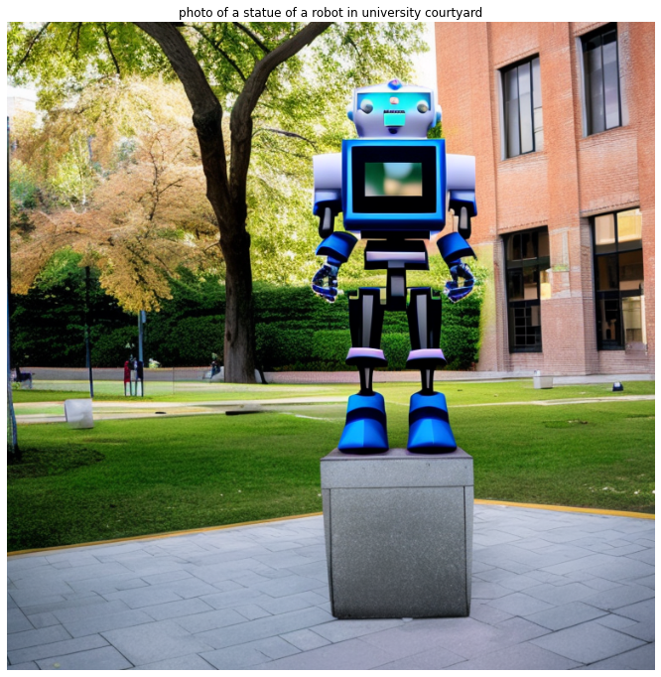







BLOOM
BLOOM
BLOOM
© 2023, Amazon Web Services, Inc. or its affiliates. All rights reserved.
Notes:
Generative AI has taken the world by storm because we’ve been able to–through consumer-facing applications like ChatGPT—experience how powerful the latest machine learning models have become.
Generative AI is a type of AI that can create new content and ideas, including conversations, stories, images, videos, and music. Like all AI, generative AI is powered by ML models— but generative AI is powered by very large models that are pre-trained on vast amounts of data and commonly referred to as foundation models (FMs).
Transition: How is Generative AI different than other types of AI like machine learning or deep learning?

Slide 4
Question: What is generative AI?
Creates new content and ideas, including conversations, stories, images, videos, and music
Powered by large models that are pretrained on vast corpora of data and commonly referred to as foundation models (FMs)
BLOOM
BLOOM
BLOOM
© 2023, Amazon Web Services, Inc. or its affiliates. All rights reserved.
Notes:
Generative AI has taken the world by storm because we’ve been able to–through consumer-facing applications like ChatGPT—experience how powerful the latest machine learning models have become.
Generative AI is a type of AI that can create new content and ideas, including conversations, stories, images, videos, and music. Like all AI, generative AI is powered by ML models— but generative AI is powered by very large models that are pre-trained on vast amounts of data and commonly referred to as foundation models (FMs).
Transition: How is Generative AI different than other types of AI like machine learning or deep learning?

Slide 5
z
Pre-training
Fine-tuning
Unlocking the value of Generative AI
PURPOSE
DATA NEED
PURPOSE
DATA NEED
Maximizing accuracy for broad domain
Massive amounts of unlabeled data
Maximizing accuracy for specific tasks
Small number of labeled examples
AI
SIMPLE
SIMPLE
MACHINE LEARNING
INPUTS
OUTPUTS
DEEP LEARNING
COMPLEX
SIMPLE
INPUTS
OUTPUTS
FOUNDATION
MODELS
COMPLEX
COMPLEX
INPUTS
OUTPUTS
Notes:
<From Traditional forms of machine learning to generative AI>
Traditional forms of machine learning allowed us to take simple inputs, like numeric values, and map them to simple outputs, like predicted values.
With deep learning, we can take complicated inputs, like videos or images, and map them to relatively simple outputs, like identifying an object in an image. Is there a cat in this image, Yes or No.
And now, with generative AI, we can leverage massive amounts of complex data to capture and present knowledge in more advanced ways – mapping complicated inputs to complicated outputs, like extracting a summary and key insights from a large document.
Transition: Now that we’ve described the difference between these 3 different types of AI, let’s have a closer look at how foundation models work.

Slide 6
How does a foundation model work?
Data
Foundation model
Text
Images
Speech
Structured data
3D signals
Pre-train
*can take weeks or even months
Fine-tune for specific tasks and domains
*can take hours
Gather data at scale
Evaluate model
Notes:
<About foundation models, which are the basis of generative AI>
Foundation models are pre-trained with extremely large data sets scraped from the public internet. This process can cost millions of dollars to create because they contain hundreds of billions of hyperparameters that have been trained with hundreds of gigabytes of data. Once completed, however, each foundation model can be fine-tuned an unlimited number of times to automate a wide variety of discrete tasks, using domain specific information.

Slide 7
Job Automation Over the Years

Slide 8

The Potentially Large Effects of Artificial Intelligence on Economic Growth (Briggs/Kodnani)
Notes:
A report by Goldman Sachs talks about the fact that generative AI introduces rapid acceleration in task automation which is good news for cost savings and productivity.
Its potential ability to generate content that is indistinguishable from human-created output and to break down communication barriers between humans and machines reflects a major advancement, but this potentially has large macroeconomic effects with significant disruptions to the labor market.
Studies done on occupational tasks in both the US and Europe, the report further goes on to start that roughly two-thirds of current jobs are exposed to some degree of AI automation, and that generative AI could substitute up to one-fourth of current work. Taking these estimates globally suggests that generative AI could expose the equivalent of 300 million full-time jobs to automation.

Slide 9

Stack Overflow AI Research
Notes:
As generative AI continues to advance, it's inevitable that certain job roles will undergo transformation.
Rather than resisting it, embrace the technology and explore how it can enhance, expedite and support the work that you do today.
In recent research by Stack Overflow, 70% of more than 67,000 professional developers surveyed were already using or planning to use AI tools.
Integrating AI into enterprise tech workflows is complex, requiring careful evaluation of the potential risks and benefits.
And as use of generative AI becomes more common, organizations' technical hiring processes and internal policies will need to evolve accordingly.

Slide 10

Tech Professionals and the rapid advancements in Artificial Intelligence
Notes:
Tech professionals have a front-row seat to the rapid advancements in AI. generative AI (gen AI) is another prime example of how artificial intelligence continues to augment and transform many aspects of the world.
Earlier we looked at the different types of content that you can create using generative AI [Text, Images, Music, Stories, Videos]. With this ability to create new content and perform many tasks that were traditionally reserved for humans, Gen AI’s rapid rise and integration into everyday life has been astounding, and it has brought change and transformed jobs and functions across industries in what looks like overnight.
Not surprisingly, the prospect of Gen AI-driven capabilities and efficiencies has raised concerns about job displacement, with predictions of significant workforce disruption.

Slide 11



Second Industrial Revolution
First Industrial Revolution
Third Industrial Revolution
Notes:
So it's important to note that while generative AI has the potential to automate or augment certain tasks, it is unlikely to completely replace human professionals in most fields. Instead, it may enhance productivity, assist with repetitive or tedious tasks, and enable new forms of human-AI collaboration.
What if I told you that throughout history humans have always been dependent on technology? Of course, the technology of each era had its own shape and size. People always use the technology they had available to help make their lives easier, and at the same time try to perfect it and bring it to the next level, most times moving from a manual approach, to an automated approach to how they do work.
First Industrial Revolution
The first industrial revolution started at the end of the 18th century to the beginning of the 19th . <Click> The biggest changes came in the industries in the form of mechanization (use of machines [Engage by asking them to define mechanization]).
So this moved the societies from agriculture to the use of machines and with this, agriculture [working in the fields, by hand] was replaced by this use of machines as the backbone of the societal economy. Use of machines sped up production, so if you used to knit jerseys to sell as part of your business, you could now do this quicker by use of machines.
<Click> At the same time, the coal industry grew significantly, with the invention of steam engines that created a new type of energy that later on helped speed up the manufacturing of railroads, thus accelerating the economy. Now you got steam-powered trains which meant that goods and humans could move farther, faster.
[Engage]: First ask if any of the learners know what Industry 2.0 was – and if so, explain it to us.
<then>
What major discovery happened in the 19th century? <drop hints that hopefully lead them to the answer, electricity>
Second Industrial Revolution
The Second Industrial Revolution began in the 19th century through the discovery of <Click> electricity and <Click> the assembly line production. Henry Ford (1863-1947) took the idea of mass production into automobile production and drastically altered it in the process. While before one station assembled an entire automobile, now the vehicles were produced in partial steps on the conveyor belt - significantly faster and at lower cost.
[Engage]: First ask if any of the learners know what Industry 3.0 was – and if so, explain it to us.
<then>
This happened in the ‘70s? Can you think what it is? <drop hints that hopefully lead them to the answer, computers> <Click>
Third Industrial Revolution (Digital Revolution)
The Third Industrial Revolution began in the ’70s in the 20th century through partial automation using memory-programmable controls and computers. Since the introduction of these technologies, we are now able to automate an entire production process - without human assistance. Known examples of this are robots that perform programmed sequences without human intervention.

Slide 12

Information
Communication Technologies
Notes:
[Engage]: First ask if any of the learners know what Industry 4.0 was – and if so, explain it to us.
<then>
This happened in the ‘70s? Can you think what it is? <drop hints that hopefully lead them to the answer, computers>
Fourth Industrial Revolution
We are in the Fourth Industrial Revolution. We are applying (or combining) information and communication technologies to how we do things.
It’s taking the Third Industrial Revolution to the next level.
<Here, if the conversation allows, discussions on what 4IR is allowing us to do, usually work>

Slide 13
generative AI & Tech Careers
Notes:
Here we discuss only a few tech roles which are set to be augmented by generative AI. Speaker can insert any roles as preferred or to suit the audience.

Slide 14

Software Engineers and the rapid advancements in Artificial Intelligence
Notes:
Software engineers have a front-row seat to the rapid advancements in AI. generative AI (gen AI) is another prime example of this of how artificial intelligence continues to augment and transform many aspects of the world.
Generative AI has the power to augment and enhance numerous tech roles and tasks. For software developers, AI-powered code assistants like Amazon Q Developer can generate code snippets, automate repetitive tasks, and accelerate the development process.
generative AI will revolutionize software development by automating routine tasks, enabling rapid prototyping and customizing solutions.
Developers can leverage AI for code suggestions and bug detection—even generate code segments to reduce development time.

Slide 15

- Data reports and summaries
- Data interpretation and insights
- Academic research and writing
Notes:
As the use of generative AI grows, the role of data scientist is poised for significant evolution.
This technology promises to streamline operations such as data cleansing and feature engineering, allowing data professionals to pivot toward more inventive and strategic endeavors, such as formulating novel or fundamental machine learning models and insightful results interpretation.
1. Data scientists will be sought after to navigate and uncover insights from large datasets.
Proficiency in Python, a key programming language for AI development, will be highly valued. Professionals with expertise in modeling, computational intelligence, machine learning, mathematics, psychology, linguistics and neuroscience will find themselves in high demand. These specialized skills will be essential in creating and refining AI models, ensuring their accuracy and effectiveness.
2. Data Analysts spend a big portion of time creating data reports and summaries, then interpreting these reports and drawing insights from them.
Now, with capabilities such as Amazon Q in QuickSight, business users can now generate compelling sharable stories examining their data, see executive summaries of dashboards surfacing key insights from data in seconds, and confidently answer questions of data not answered by dashboards and reports with a reimagined Q&A experience.
https://aws.amazon.com/quicksight/q/

Slide 16

- Writing articles, stories, scripts, and reports
- Generating product descriptions and marketing copy
- Creating social media posts and captions
Notes:
Content creators spend time
writing articles, stories, scripts, and reports,
Generating product descriptions and marketing copy
Creating social media posts and captions
With various foundation models that now support content generation, content creators get to automate various tasks associated with content creation.

Slide 17

AI Ethicist
Notes:
There’s a growing need to address complex issues surrounding AI ethics and regulation. The role of an AI ethicist is multidisciplinary and includes ensuring ethical AI development; upholding governance standards on transparency, bias and explainability; and ensuring accountability in addressing legitimate concerns of content and copyright owners.

Slide 18

Cloud Engineer
Notes:
“Cloud roles have much to gain from the rise of generative AI. With generative AI, cloud practitioners can streamline their workloads by automating basic infrastructure coding, help realize cloud cost savings by optimizing infrastructure for attributes such as cost and speed, and aid cloud security by identifying data anomalies. The benefits of generative AI for cloud practitioners are endless.” - Aaron Skonnard, Pluralsight

Slide 19
Challenges & Concerns
Notes:
While the potential of generative AI is undeniable, there are valid concerns and challenges that must be addressed. One major concern is the potential for job displacement, as AI automation could impact certain roles and tasks. There are also ethical considerations around issues such as privacy, bias, and the potential for misuse of generative AI technologies.

Slide 20
Finding a balance in building generative AI
Innovation
Emerging risks and challenges
Notes:
It’s important that we find a balance between all of the promise that generative AI brings – to transform industries and enable new innovation – with the risks and challenges we have seen emerge at the same time. It is when we have that balance in place that we will take advantage of all that generative offers, while ensuring the safe, secure, and transparent development of the technology.

Slide 21
Educate
People-centered approach
Focus on people, process, and culture to build trust
Build diverse teams
Take a holistic approach
Engage with multi-stakeholder organizations
Notes:
It is essential that we take a people centered approach to responsible AI – that spans people, process, and culture to build trust. Our approach starts with education and doing our part to build the next generation of developers and data scientists in AI – with new courses on bias mitigation and fairness that is available to everyone. Education extends beyond technology to people, process, and culture to build awareness for the value in building diverse teams, why responsible AI matters, and the role we all have to advocate for it. Responsible AI is not work that can be done in a silo – it is truly a multidisciplinary effort that requires technology companies, policy makers, community groups, scientists, and others to come together to tackle new challenges as they arise.
At AWS we have deep engagement with multi-stakeholder organizations including the Global Partnership on AI (GPAI), Responsible AI Institute, The Partnership on AI, and National Artificial Intelligence Advisory Committee to share best practices, accelerate research, and responsibly develop AI and ML technology.

Slide 22
Preparing for a generative AI future
Notes:
To navigate the generative AI revolution successfully, a multifaceted approach is required. Employers need to invest in training programs, scenario planning, and the development of AI governance policies to ensure responsible and ethical adoption of these technologies. At the same time, employees must cultivate a growth mindset, embracing continuous learning and developing transferable skills that will remain valuable in an AI-driven workforce.
Collaboration between humans and AI systems will be key, as we leverage the strengths of both to drive innovation and solve complex problems. By fostering a culture of human-AI collaboration and promoting diversity and inclusion in the development and deployment of generative AI, we can create a more equitable and beneficial future for all.
Moreover, the rapid pace of AI advancement raises questions about the need for continuous upskilling and reskilling to keep up with the changing job landscape. Employers and employees alike must be prepared to adapt and embrace a culture of lifelong learning.

Slide 23

Training and upskilling
Scenario planning
Embrace continuous learning
Develop AI governance policies
Promote human AI collaboration
Reskilling support
Transparency in communication
Employers & generative AI
Notes:
Here are some ways employers can better prepare their employees for the increasing adoption of generative AI:
1. Training and upskilling: Provide training programs to educate employees about generative AI, its capabilities, limitations, and ethical considerations. Teach them how to effectively use and interact with these tools in their respective roles.
2. Scenario planning: Conduct exercises and workshops to analyze how generative AI could impact different departments, processes, and job roles within the organization. Identify potential opportunities, challenges, and necessary adaptations.
3. Embrace a culture of continuous learning: Encourage a mindset of continuous learning and adaptability among employees. As generative AI evolves rapidly, employees must be willing to acquire new skills and embrace change.
4. Develop AI governance policies: Establish clear policies and guidelines for the responsible and ethical use of generative AI within the organization. Address issues such as data privacy, bias mitigation, and intellectual property rights.
5. Promote human-AI collaboration: Foster an understanding that generative AI is a tool to augment and assist human workers, not replace them. Emphasize the value of human judgment, creativity, and emotional intelligence in combination with AI capabilities.
6. Reskilling and job transition support: For roles that may be significantly impacted by generative AI, provide reskilling opportunities or support for employees to transition into new roles within the organization.
7. Communicate transparently: Maintain open and transparent communication about the organization's plans for adopting generative AI, addressing employee concerns, and involving them in the decision-making process.
By taking a proactive and inclusive approach, employers can help their workforce develop the necessary skills and mindset to effectively leverage generative AI while mitigating potential disruptions and ensuring a smooth transition.

Slide 24

Stay Informed
Develop Technical Skills
Embrace Lifelong Learning
Focus on Transferable Skills
Seek Mentorship and Support
Promote Diversity and Inclusion
Be Open to Change
Employees & generative AI
Notes:
As an employee preparing for career changes introduced by generative AI, there are several steps you can take to adapt and thrive in this evolving landscape:
1. **Stay Informed**: Stay updated on the latest developments in generative AI technology and its potential impact on your industry and profession. Follow relevant news sources, attend conferences or webinars, and participate in professional networking events to stay informed about emerging trends and opportunities.
2. **Develop Technical Skills**: Consider acquiring technical skills related to generative AI, such as machine learning, natural language processing, or data analysis. Online courses, workshops, or certificate programs can help you gain the necessary knowledge and expertise to work effectively with generative AI tools and technologies.
3. **Embrace Lifelong Learning**: Cultivate a mindset of lifelong learning and continuous skill development. Generative AI is a rapidly evolving field, and staying competitive may require ongoing education and upskilling to adapt to new technologies and methodologies.
4. **Focus on Transferable Skills**: Identify and develop transferable skills that are valuable across different roles and industries, such as critical thinking, problem-solving, creativity, and adaptability. These skills will be essential for navigating career changes and pursuing new opportunities in the era of generative AI.
5. **Seek Mentorship and Support**: Seek out mentors, sponsors, or professional networks that can provide guidance, advice, and support as you navigate career changes introduced by generative AI. Connect with other women in technology or related fields to share experiences, exchange insights, and build a supportive community.
6. **Promote Diversity and Inclusion**: Advocate for diversity and inclusion in the development and deployment of generative AI technologies. Encourage companies and organizations to prioritize diversity in their hiring practices, foster inclusive work environments, and address bias and discrimination in AI systems.
7. **Be Open to Change**: Embrace change as an opportunity for growth and exploration. Stay flexible and open-minded as you navigate career transitions and consider how generative AI can be leveraged to create new opportunities for innovation, collaboration, and advancement.
By taking proactive steps to prepare yourself for career changes introduced by generative AI, you can position yourself for success and contribute to shaping a more inclusive and equitable future in the AI-driven workforce.

Slide 25
Conclusion
OPPORTUNITIES
Human-machine collaboration
Innovation
Creativity
Productivity
CHALLENGES
An emerging technology
Notes:
The rise of Gen AI is introducing both challenges and opportunities for tech professionals, but it'll be crucial to approach this transformative landscape with adaptability and continuous learning. generative AI has the potential to reshape the nature of work for a number of jobs, but it also presents exciting opportunities for new roles that may not yet exist.
Human-machine collaboration will play a crucial role in maximizing the benefits of generative AI, as humans possess unique qualities like creativity and emotional intelligence. By embracing this partnership between humans and machines, we can shape a future where technology complements human skills and fosters innovation.
It's important to maintain a balanced perspective, understanding that the impact of generative AI on the job landscape will be significant but that humans remain an indispensable part of the equation.

Slide 26
Start your generative AI journey today
1
2
Deploy Amazon Q Developer for immediate productivity gains
Explore FMs through
Amazon Bedrock
Notes:
2/ Get started as soon as possible with FMs through Amazon Bedrock (preview)

Slide 27
Start your generative AI journey today
1
2
3
Deploy Amazon Q Developer for immediate productivity gains
Explore FMs through
Amazon Bedrock
Get started on a PoC for your top use cases
Notes:
3/ Work towards a proof of concept with help from AWS experts, who can guide customers through their generative AI journey on solving diverse business problems, aligning business and technical stakeholders, and building an executable roadmap.

Slide 28



Getting started
Get started with Amazon Bedrock
Discover features with a step-by-step tutorial
Dive deep with a
hands-on workshop
Notes:
Workshop for Bedrock - https://catalog.us-east-1.prod.workshops.aws/workshops/a4bdb007-5600-4368-81c5-ff5b4154f518/en-U

Slide 29

PartyRock Hackathon
Notes:
Survey https://www.pulse.aws/survey/ERPY87WP

Slide 30

What will you build using generative AI?
Send us your feedback
Notes:
Survey https://www.pulse.aws/survey/ERPY87WP

Slide 31

Generative AI and the Future of Work
Notes:
https://www.linkedin.com/pulse/generative-ai-future-work-veliswa-boya-z348f/

